Slide 1
Scalable Multi-Period Optimal Power Flow for Active Power Distribution Systems or simply, Scalable MP-OPF in ADS
Aryan Ritwajeet Jha
Graduate Research Assistant
Washington State University
Notes:
Remember to hit the reset button to make sure all the page elements react properly.
There are 20 different layouts that you can choose from.

Slide 2
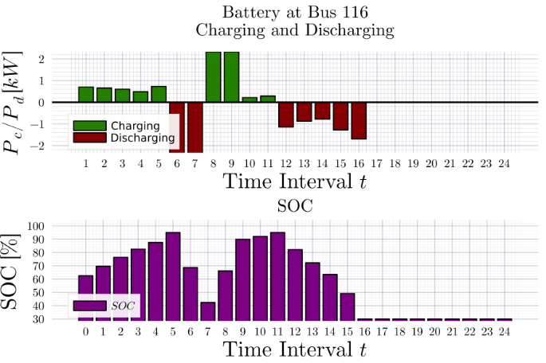
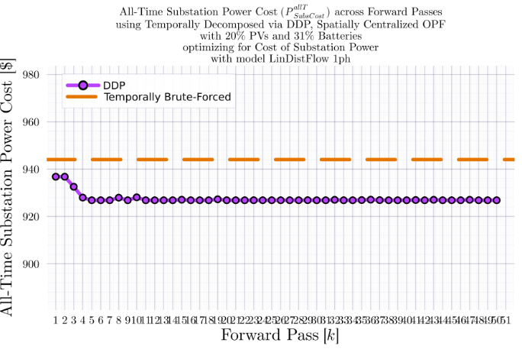
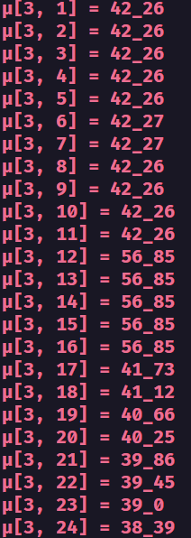
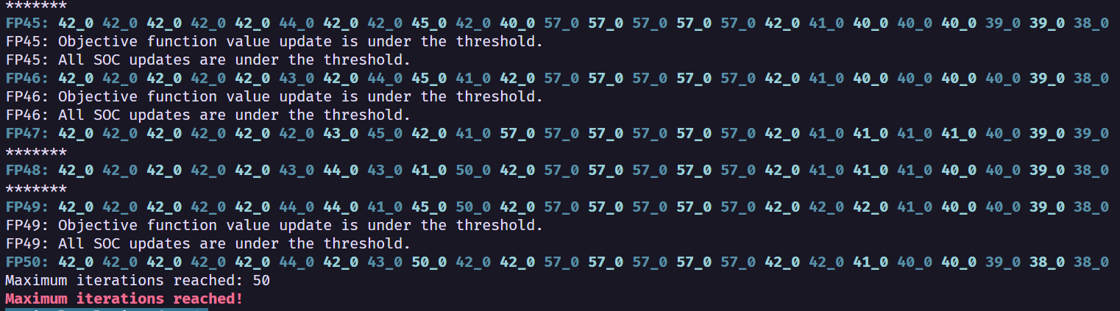
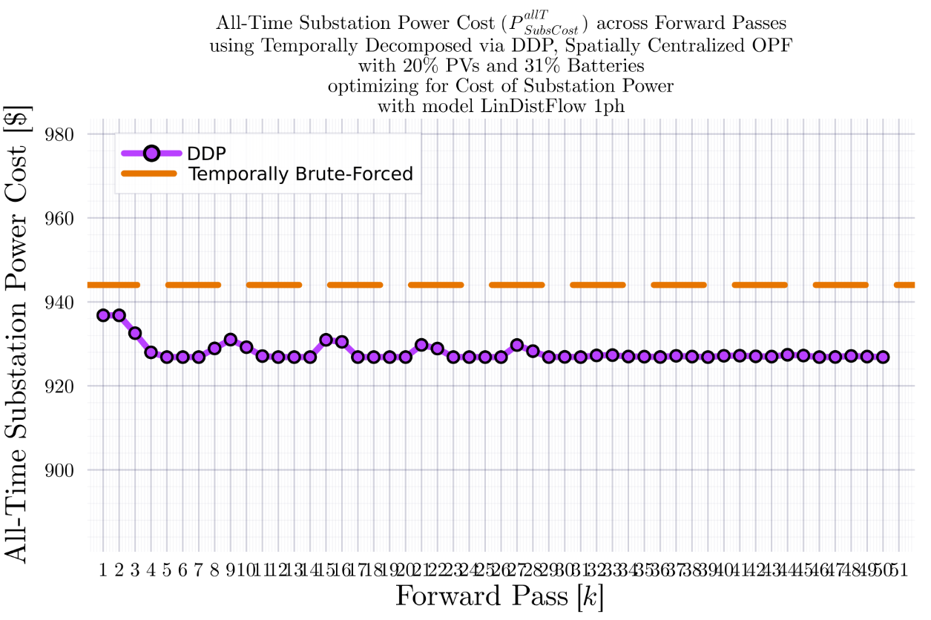
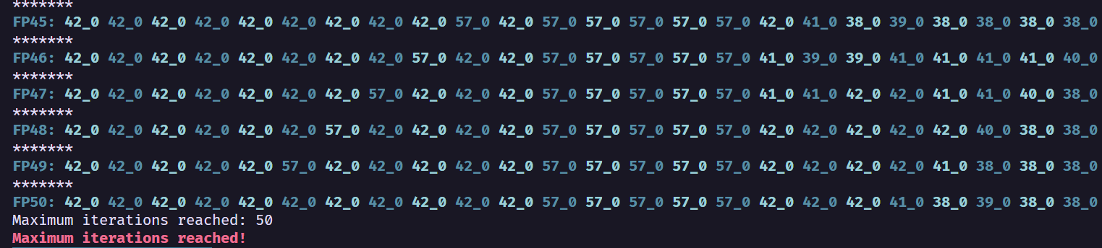
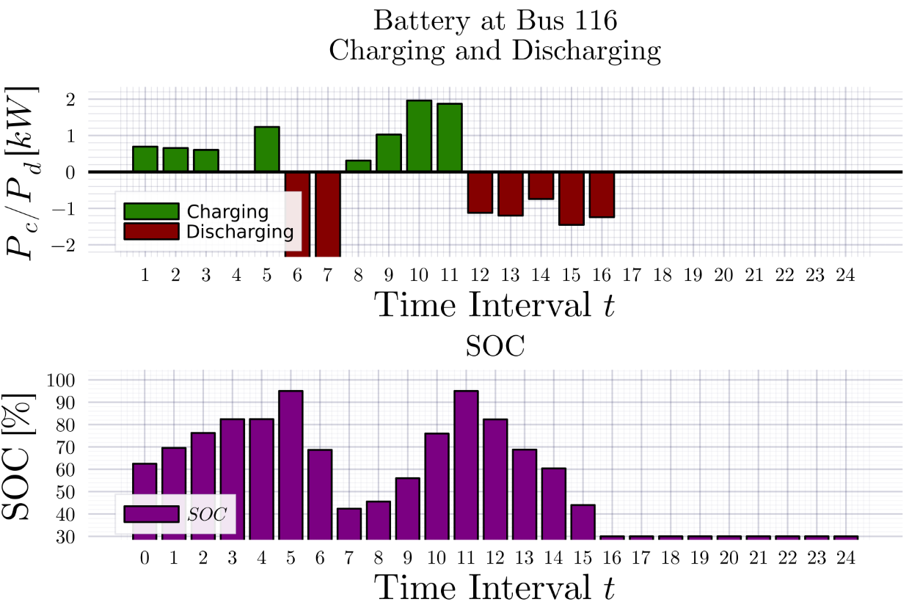
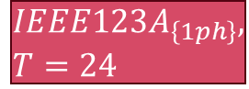
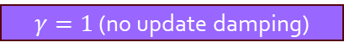

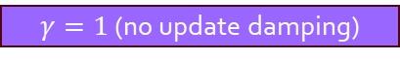


DDP Trajectory vs #Forward Passes $[k]$: LinDistFlow Model Terminal SOC Constraint Relaxed
$$IEEE123A_{\left\{1ph\right\}}, T=24$$
BruteForced (BF)
$$DDP$$
$γ=1$ (no update damping)
$γ=1$ (no update damping)
$$γ=0.5$$
$$γ=0.5$$
$$k_{Max}=25$$

Slide 3

Latest Slides End Here. Previous Slides Follow.

Slide 4
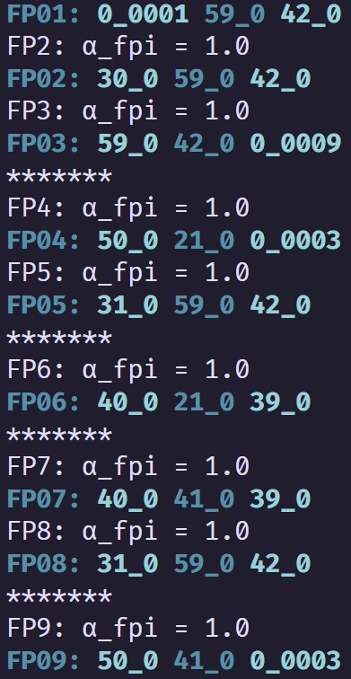
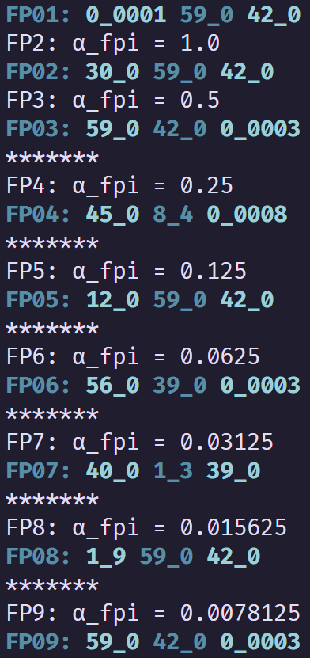
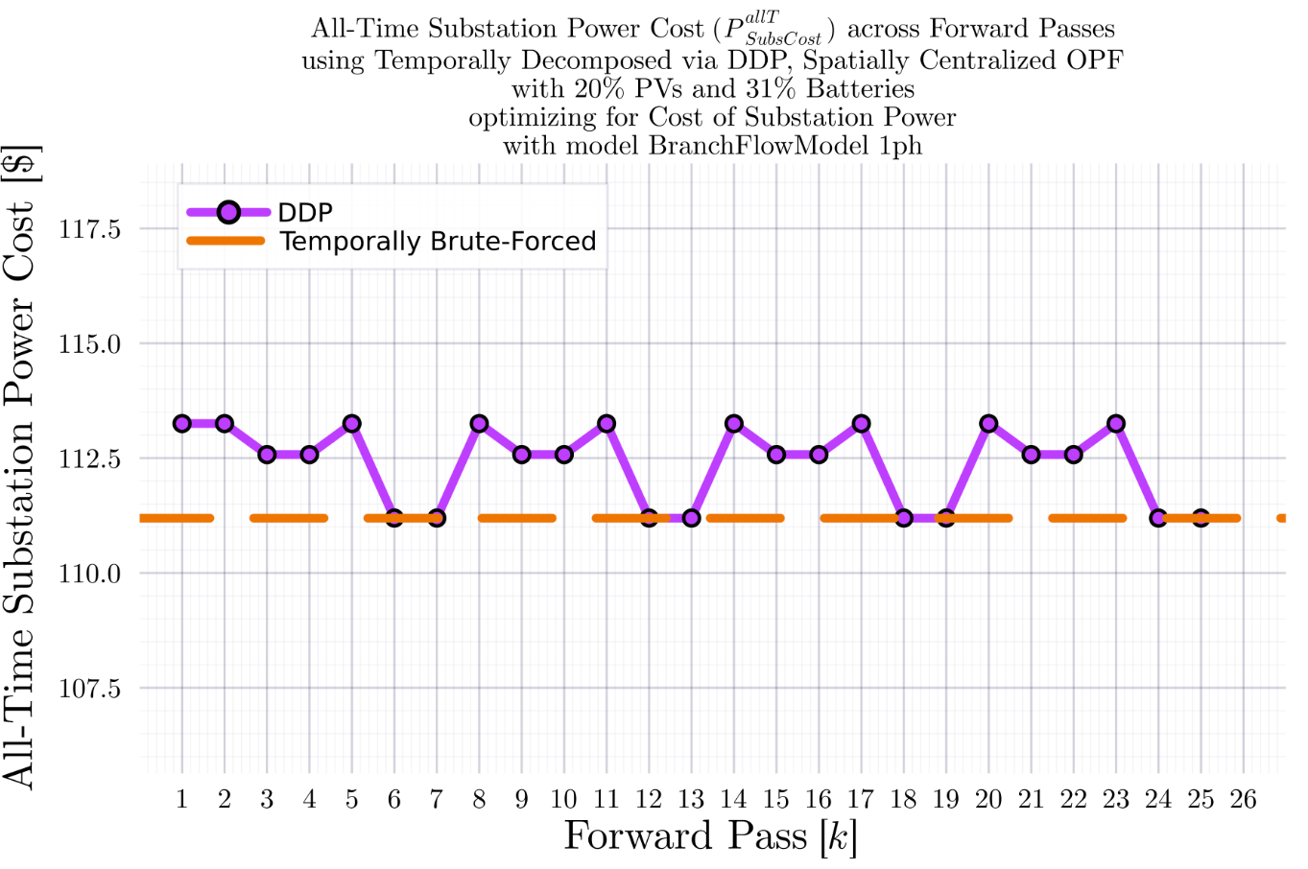
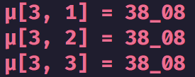

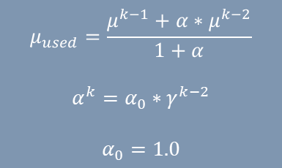
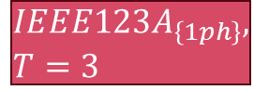



DDP Trajectory vs #Forward Passes $[k]$ Terminal SOC Constraint Relaxed
$$IEEE123A_{\left\{1ph\right\}}, T=3$$
BruteForced (BF)
$$DDP$$
$$FP\left(k\right):μ_{k}\left(t=1\right), μ_{k}\left(t=2\right), μ_{k}(t=3)$$
$$μ_{used}=\frac{μ^{k−1}+α∗μ^{k−2}}{1+α}$$
$$α^{k}=α_{0}∗γ^{k−2}$$
$$α_{0}=1.0$$
$γ=1$ (no update damping)
$$γ=0.5$$
$$k_{Max}=25$$
$γ=1$ (no update damping)
$$γ=0.5$$
Fluctuation ${\text{of} μ}_{k}^{T}$ value between $0$ and a ‘regular’ non-zero value

Slide 5
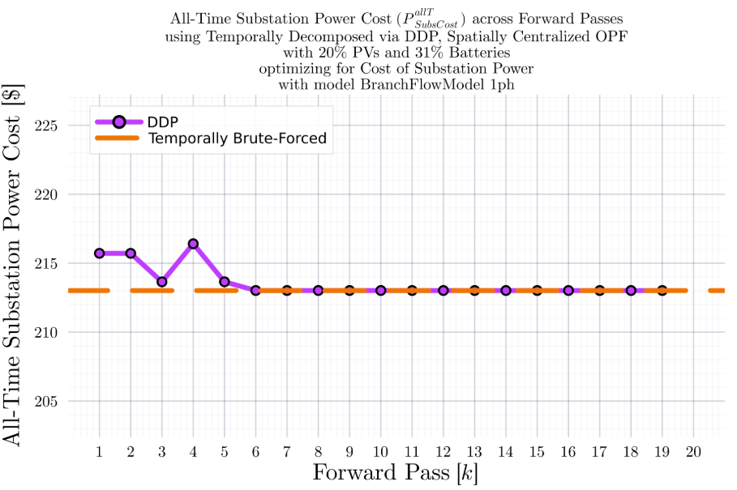
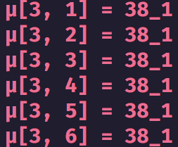
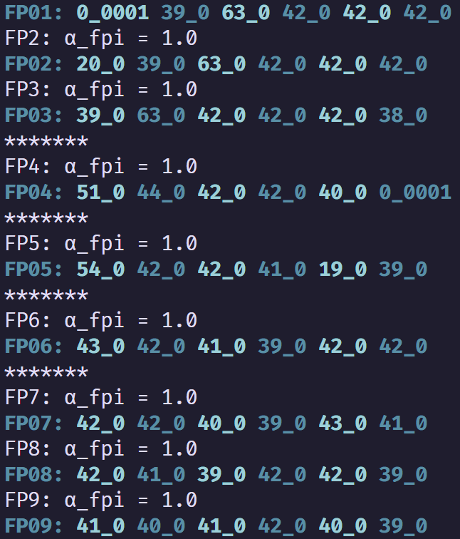
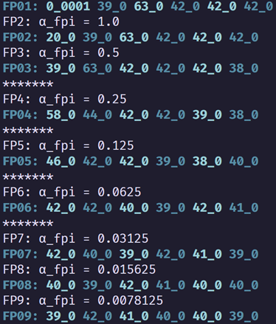
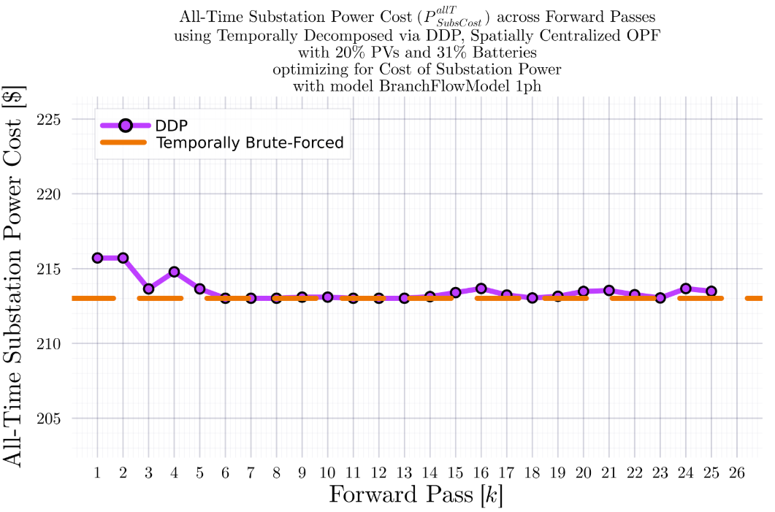
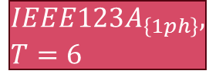
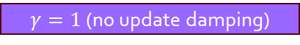

DDP Trajectory vs #Forward Passes $[k]$ Terminal SOC Constraint Relaxed
$$IEEE123A_{\left\{1ph\right\}}, T=6$$
BruteForced (BF)
$$DDP$$
$γ=1$ (no update damping)
$$γ=0.5$$
$γ=1$ (no update damping)
$$γ=0.5$$
$$k_{Max}=25$$

Slide 6
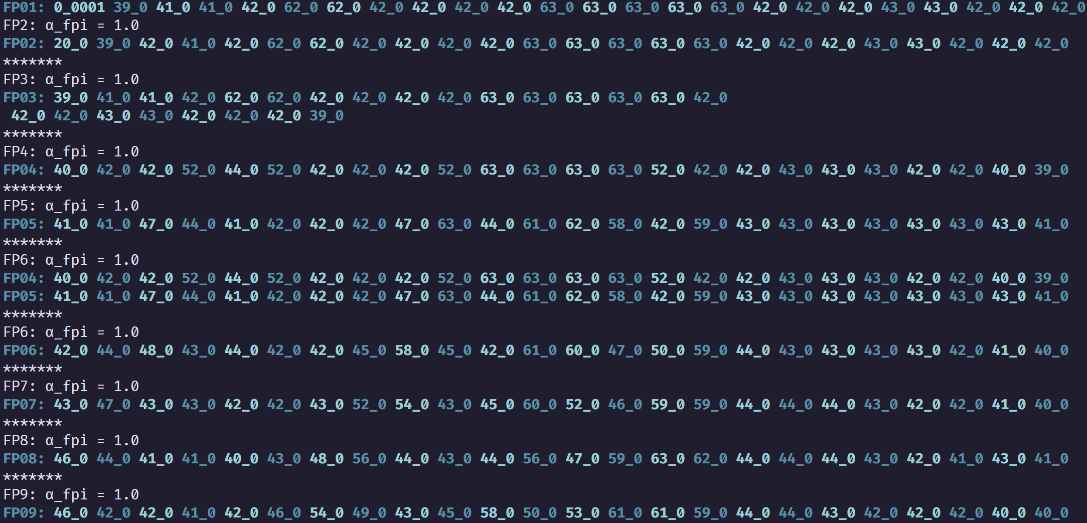
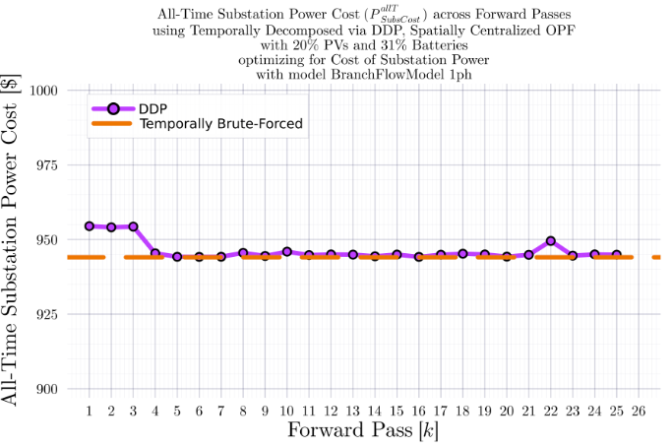
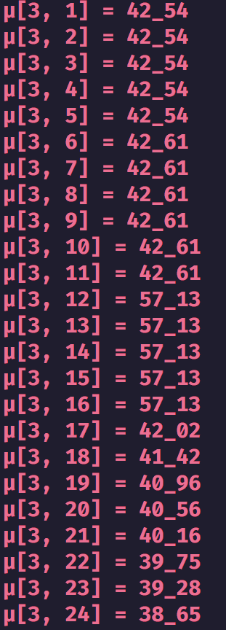
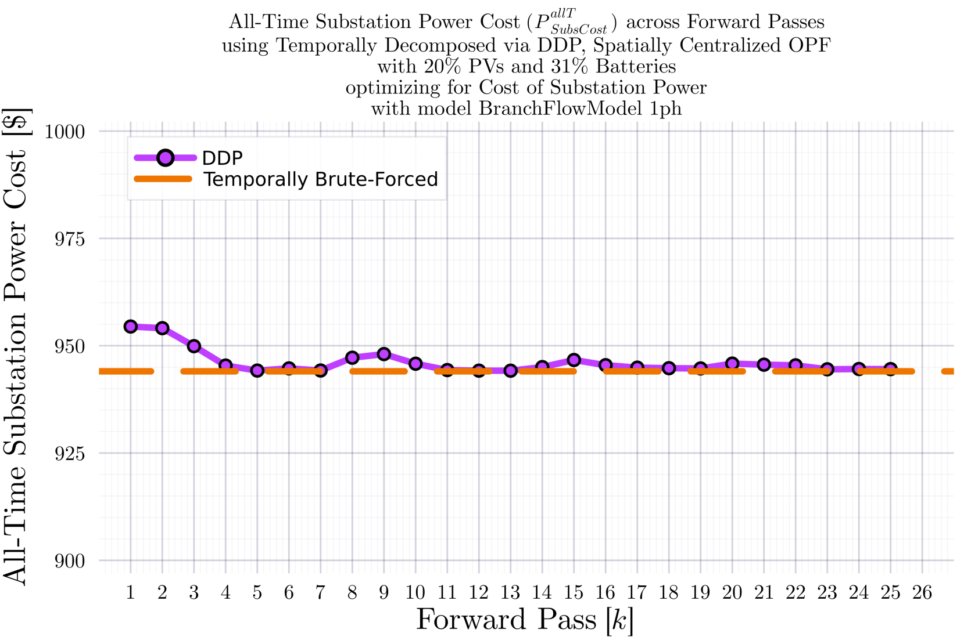
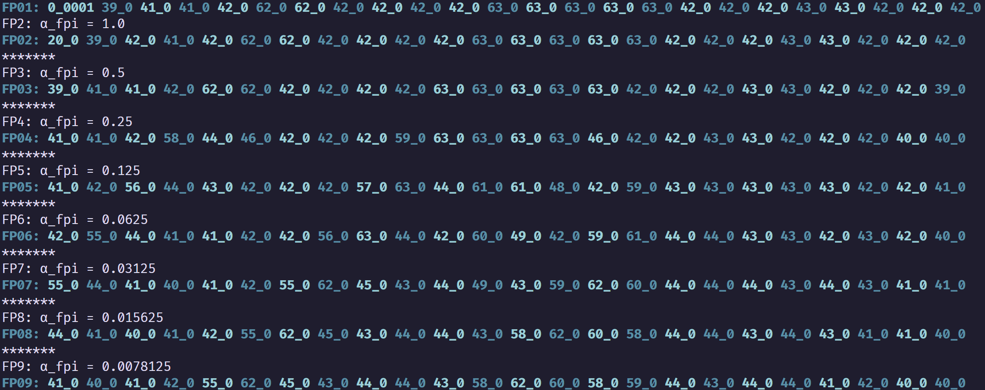
DDP Trajectory vs #Forward Passes $[k]$ Terminal SOC Constraint Relaxed
$$IEEE123A_{\left\{1ph\right\}}, T=24$$
BruteForced (BF)
$$DDP$$
$γ=1$ (no update damping)
$γ=1$ (no update damping)
$$γ=0.5$$
$$γ=0.5$$
$$k_{Max}=25$$

Slide 7
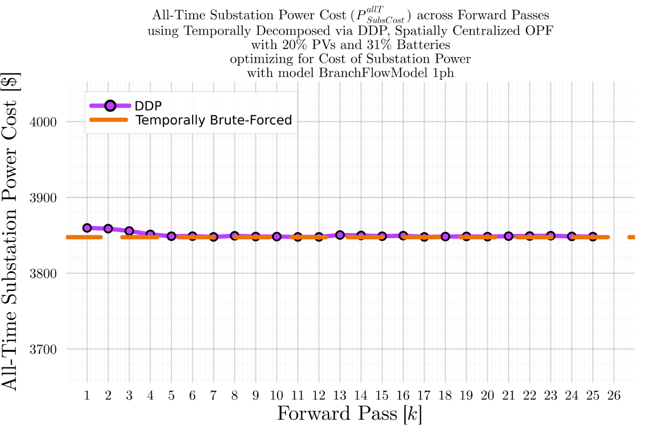
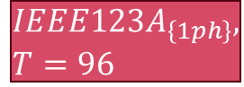

DDP Trajectory vs #Forward Passes $[k]$ Terminal SOC Constraint Relaxed
$$IEEE123A_{\left\{1ph\right\}}, T=96$$
BruteForced (BF)
$$DDP$$
$$k_{Max}=25$$

Slide 8
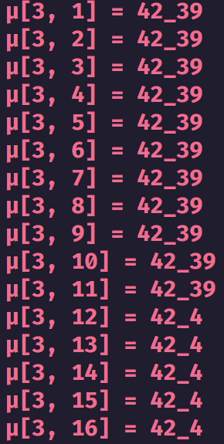
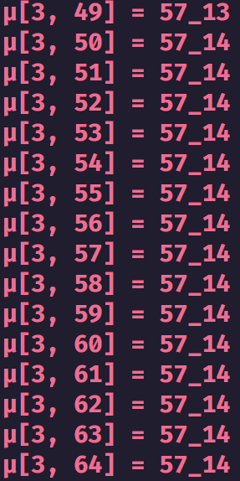
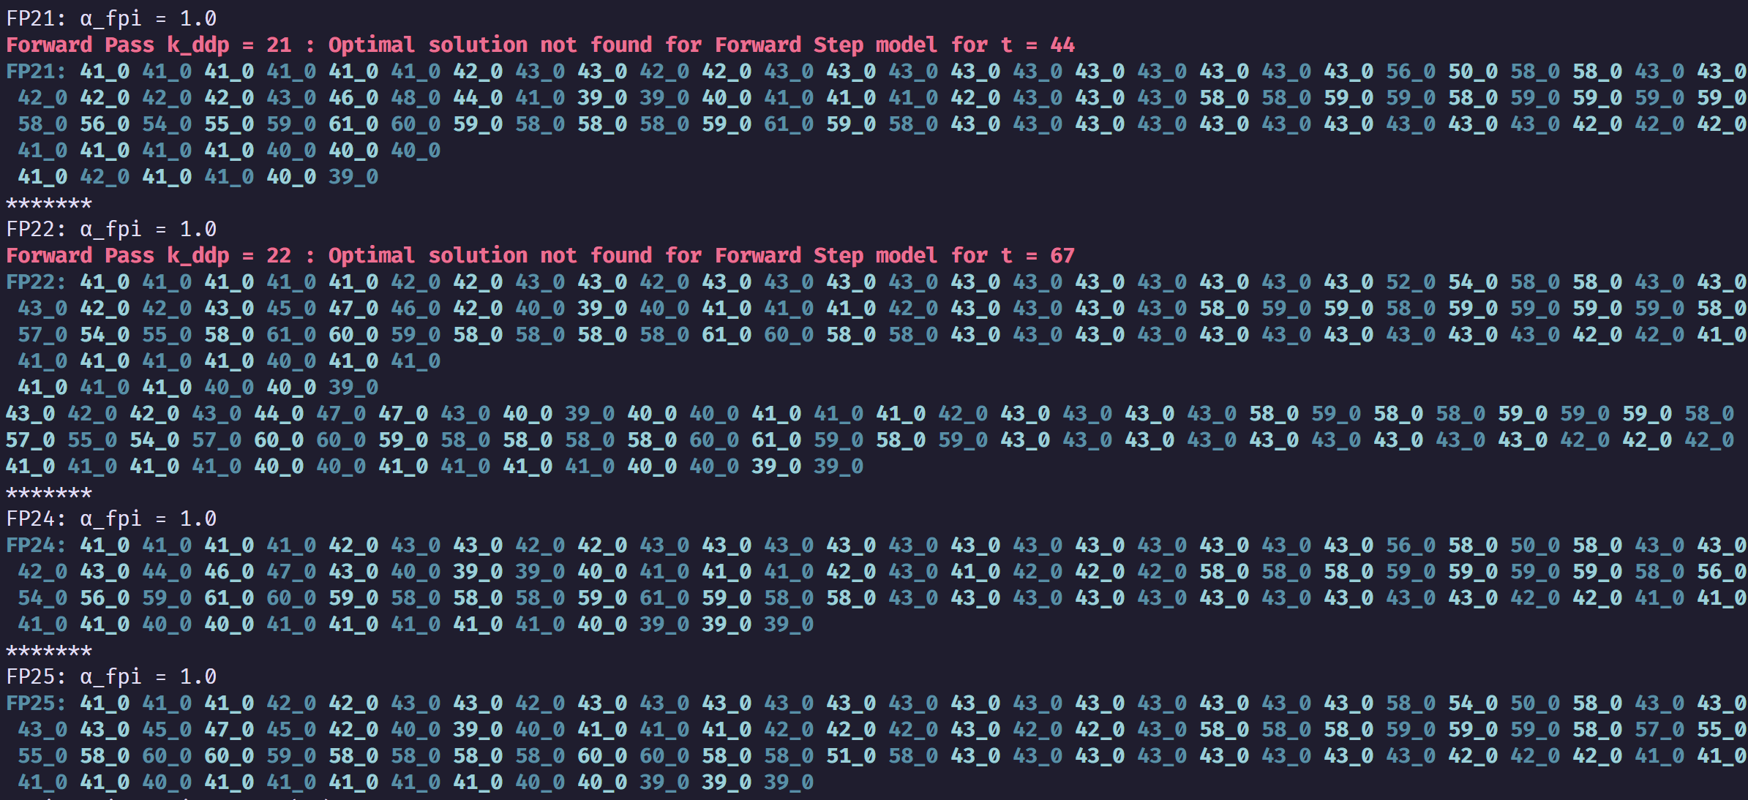
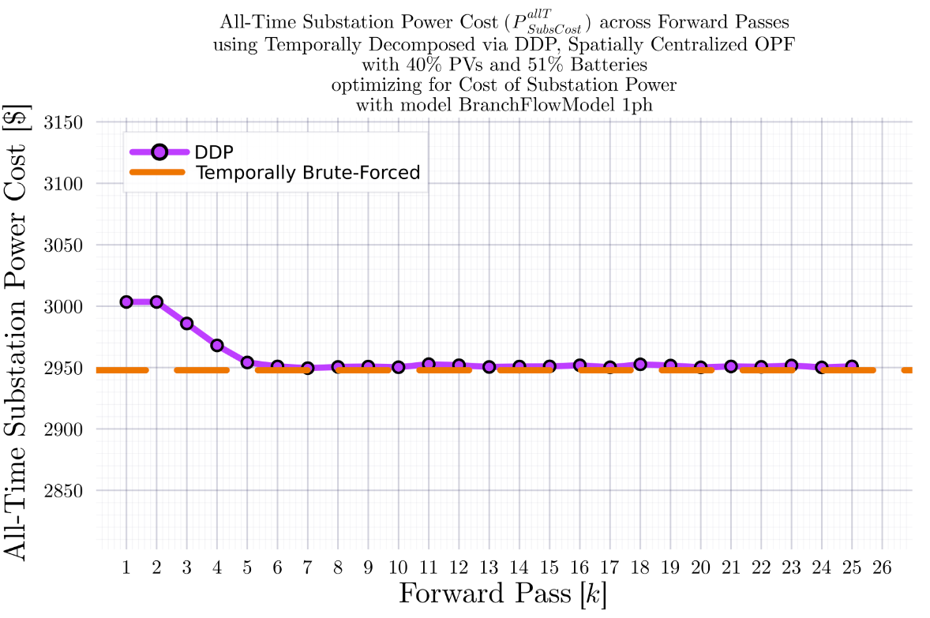
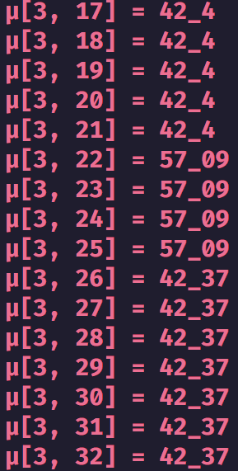
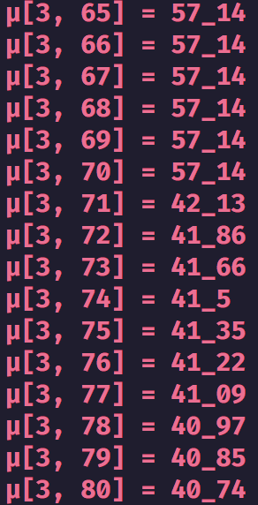
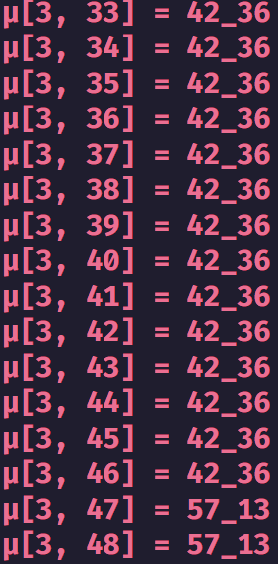
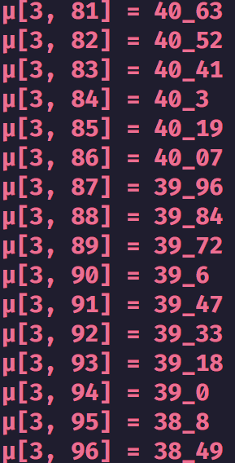
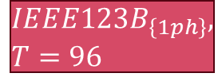

DDP Trajectory vs #Forward Passes $[k]$ Terminal SOC Constraint Relaxed
$$IEEE123B_{\left\{1ph\right\}}, T=96$$
BruteForced (BF)
$$DDP$$
$γ=1$ (no update damping)
$γ=1$ (no update damping)
$$k_{Max}=25$$

Slide 9
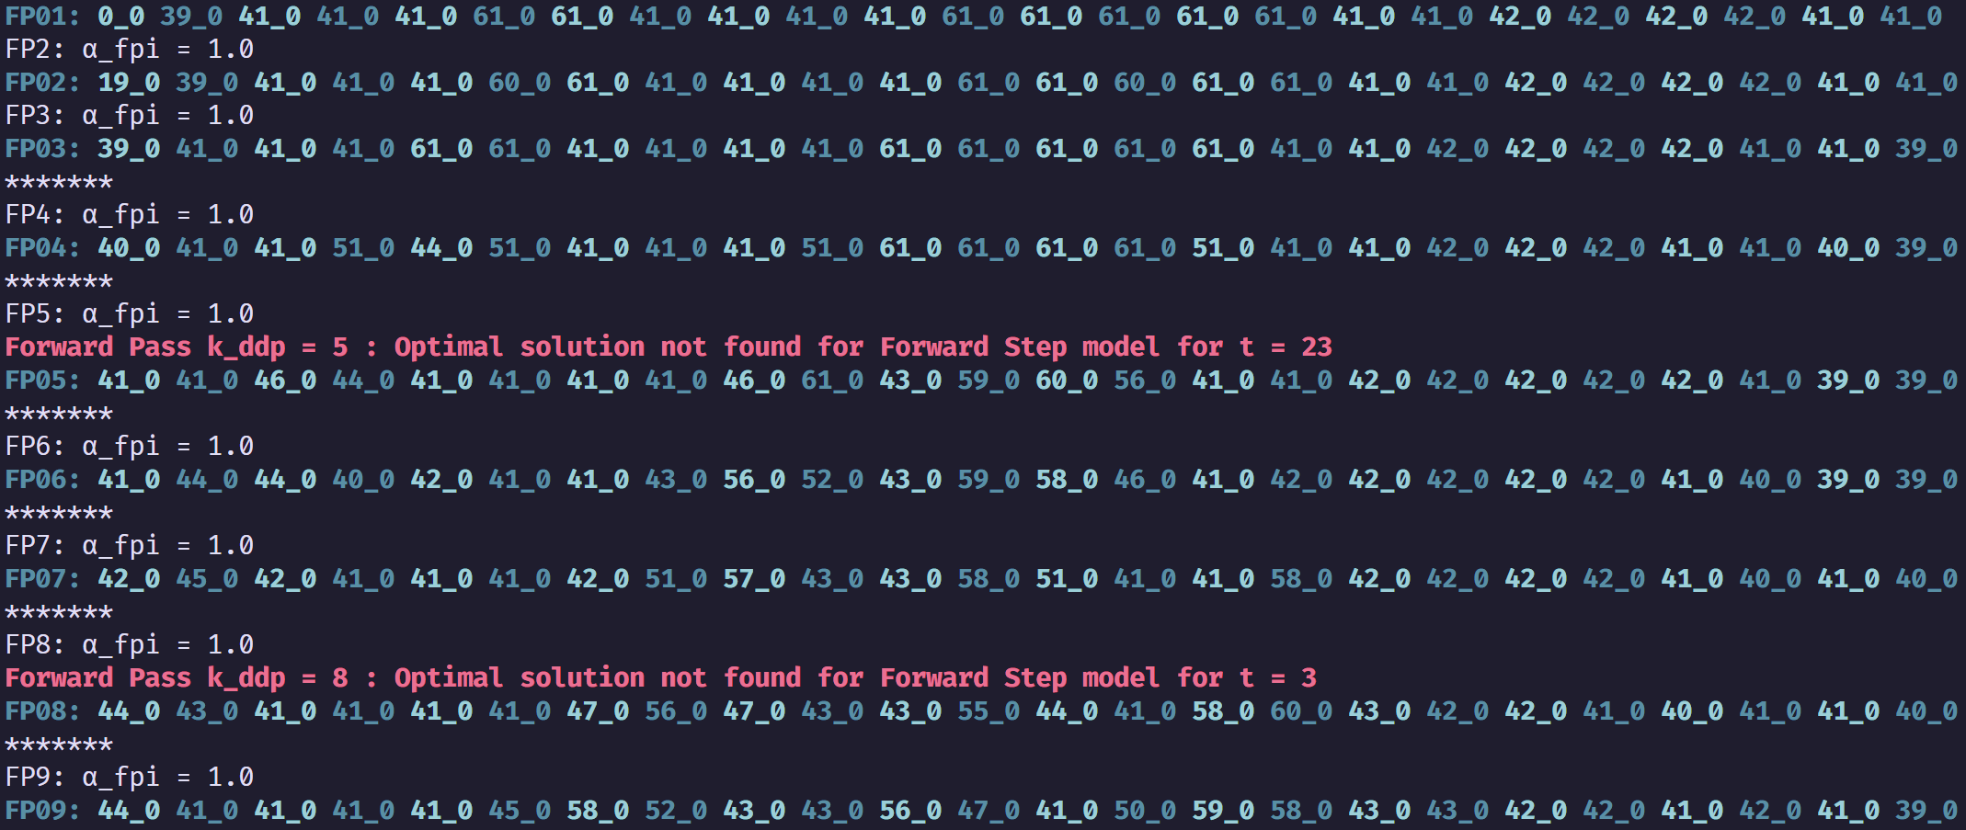
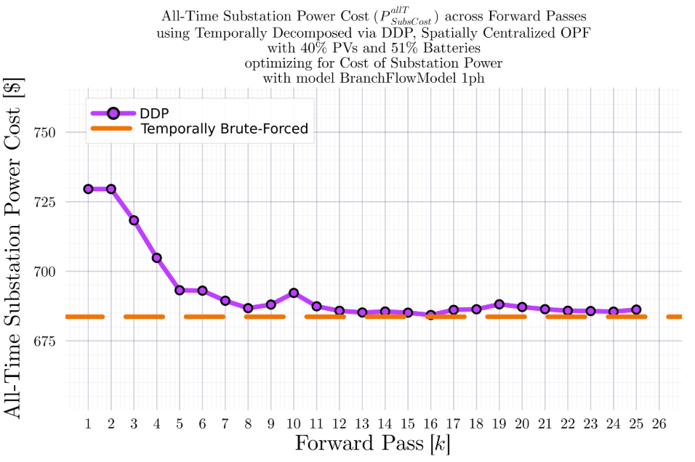
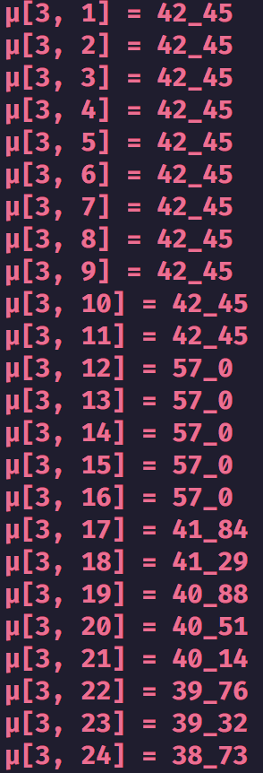
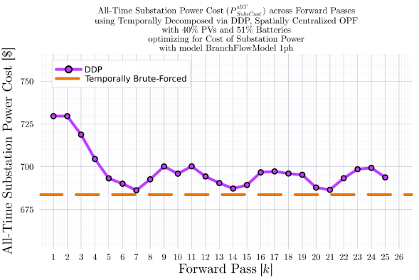
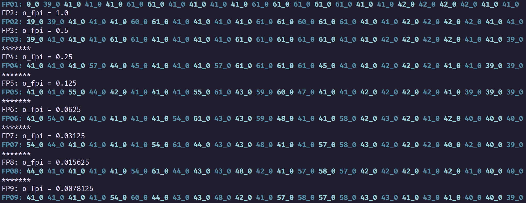
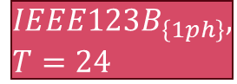



DDP Trajectory vs #Forward Passes $[k]$ Terminal SOC Constraint Relaxed
$$IEEE123B_{\left\{1ph\right\}}, T=24$$
BruteForced (BF)
$$DDP$$
$γ=1$ (no update damping)
$γ=1$ (no update damping)
$$γ=0.5$$
$$γ=0.5$$
$$k_{Max}=25$$

Slide 10
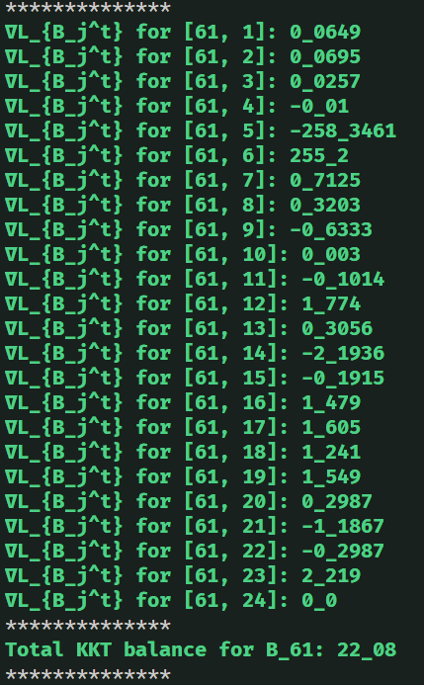
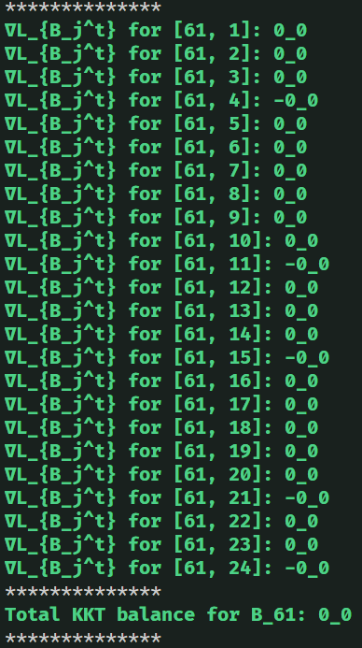
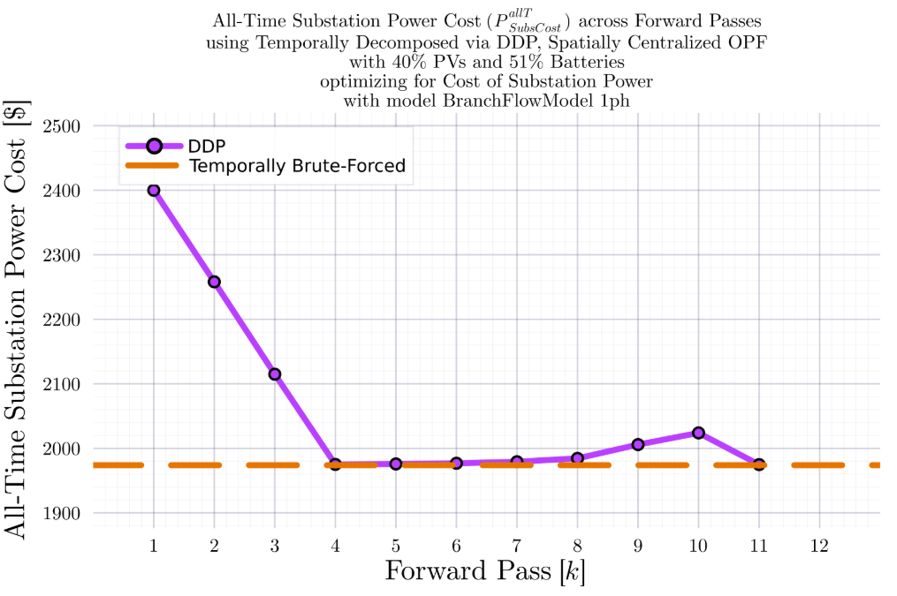

DDP Trajectory vs #Forward Passes $[k]$ Terminal SOC Constraint Relaxed
$$IEEE123B_{\left\{1ph\right\}}, T=24$$
BruteForced (BF)
$$DDP$$
$$k_{Max}=11$$

Slide 11
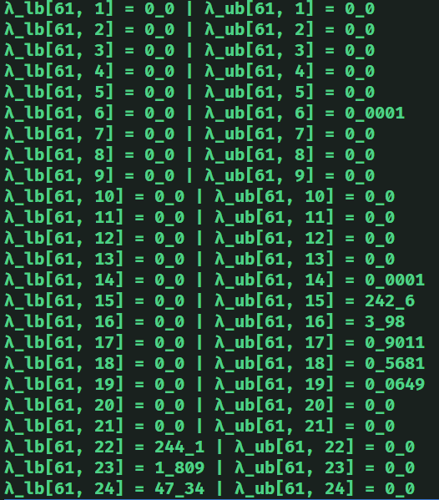
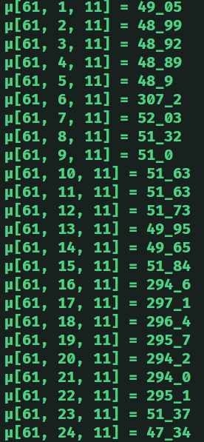


DDP Trajectory vs #Forward Passes $[k]$ Terminal SOC Constraint Relaxed
$$IEEE123B_{\left\{1ph\right\}}, T=24$$
$$DDP$$
$$k_{Max}=11$$

Slide 12




DDP Trajectory vs #Forward Passes $[k]$ Terminal SOC Constraint Relaxed
$$IEEE123B_{\left\{1ph\right\}}, T=24$$
BruteForced (BF)

Slide 13



DDP Trajectory vs #Forward Passes $[k]$ Terminal SOC Constraint Relaxed
$$IEEE123B_{\left\{1ph\right\}}, T=24$$
BruteForced (BF)
$$DDP$$
$$k_{Max}=7$$

Slide 14



DDP Trajectory vs #Forward Passes $[k]$ Terminal SOC Constraint Relaxed
$$IEEE123B_{\left\{1ph\right\}}, T=24$$
$$DDP$$
$$k_{Max}=11$$

Slide 15


DDP Trajectory vs #Forward Passes $[k]$ Terminal SOC Constraint Relaxed
$$IEEE123B_{\left\{1ph\right\}}, T=24$$
BruteForced (BF)
$$DDP$$
$$k_{Max}=25$$

Slide 16



DDP Trajectory vs #Forward Passes $[k]$ Terminal SOC Constraint Relaxed
$$IEEE123B_{\left\{1ph\right\}}, T=24$$
$$DDP$$
$$k_{Max}=25$$

Slide 17


IEEE 730 1ph Node System
34 12.66kV to 12.66kV branches (high impedance)
43 12.66kV to 0.24kV branches (low impedance)
$$k{V_{B}}_{Sys}=0.24$$
$$kV_{B_{Sec}}=0.24$$
$$kV_{B_{Pri}}=12.66$$
$$MV{A_{B}}_{Sys}=100$$
$$MVA_{B_{Xfm}}=0.07$$
$$Z_{B_{Sys}}=Z_{B_{Sec}}=0.000576$$
$$Z_{B_{Pri}}=1.602756$$
1
2
2
2
1
4
1
1
1
0
1
4
1
1
1
1
2
1
2
1
1
1
1
1
1
1
1
1
1
1
1
1
0
1
0
1

Slide 18


Comparison of BFM-NL-1ph and LinDistFlow-1ph Optimization Results
LinDistFlow Optimal Actions used in OpenDSS
BFM-NL
Optimal Actions used in OpenDSS

Slide 19


Comparison of BFM-NL-1ph and LinDistFlow-1ph Optimization Results
LinDistFlow Own Solutions
BFM-NL Own Solutions

Slide 20


Comparison of BFM-NL-1ph and LinDistFlow-1ph Optimization Results
LinDistFlow
BFM-NL

Slide 21








DDP Trajectory vs #Forward Passes $[k]$ Terminal SOC Constraint Relaxed
$$ADS{10}_{1ph}, T=96$$
BruteForced (BF)
$$DDP$$
Looks ‘successful’
$$k_{Max}=33$$

Slide 22







DDP Trajectory vs #Forward Passes $[k]$ Terminal SOC Constraint Relaxed
$$IEEE{123}_{1ph}, T=96$$
BruteForced (BF)
$$DDP$$
Looks ‘successful’
$$k_{Max}=33$$

Slide 23







DDP Trajectory vs #Forward Passes $[k]$ Terminal SOC Constraint Relaxed
$$ADS{10}_{1ph}, T=24$$
BruteForced (BF)
$$DDP$$
Looks ‘successful’
$$k_{Max}=33$$

Slide 24






DDP Trajectory vs #Forward Passes $[k]$ Terminal SOC Constraint Relaxed
$$IEEE{123}_{1ph}, T=24$$
BruteForced (BF)
$$DDP$$
Looks ‘successful’
$$k_{Max}=33$$

Slide 25







DDP Trajectory vs #Forward Passes $[k]$ Terminal SOC Constraint Relaxed
$$ADS{10}_{1ph}, T=12$$
BruteForced (BF)
$$DDP$$
Will NOT converge
$$k_{Max}=33$$
Even if not converging, it at least does ‘hit’ the optimal value periodically.

Slide 26



DDP Trajectory vs #Forward Passes $[k]$ Terminal SOC Constraint Relaxed
$$ADS{10}_{1ph}, T=12$$
BruteForced (BF)
$$DDP$$
Will NOT converge
$$k_{Max}=55$$
Even if not converging, it at least does ‘hit’ the optimal value periodically.

Slide 27




DDP Trajectory vs #Forward Passes $[k]$ Terminal SOC Constraint Relaxed
$$ADS{10}_{1ph}, T=12$$
BruteForced (BF)
$$DDP$$
Will NOT converge
$$k_{Max}=77$$
Even if not converging, it at least does ‘hit’ the optimal value periodically.

Slide 28




DDP Trajectory vs #Forward Passes $[k]$ Terminal SOC Constraint Relaxed
$$ADS{10}_{1ph}, T=12$$
BruteForced (BF)
$$DDP$$
Will NOT converge
$$k_{Max}=222$$
Even if not converging, it at least does ‘hit’ the optimal value periodically.

Slide 29







DDP Trajectory vs #Forward Passes $[k]$ Terminal SOC Constraint Relaxed
$$IEEE{123}_{1ph}, T=12$$
BruteForced (BF)
$$DDP$$
Will NOT converge
$$k_{Max}=33$$
Even if not converging, it at least does ‘hit’ the optimal value periodically.

